Slide 1
Redrawing the Lines of ‘Best Practice’:
Adapting Documentary Comics to War Correspondence Practices
Presented by:
Ofer Berenstein
The Dept. of Communication Studies
(PhD Program)
University of Calgary, Canada
Please write to me at:
Ofer@giriofer.com

Slide 2
‘Best Practice’ for Documentary Comics
Is there a combined “best practice” of creating
illustrated war correspondence?
What elements - artistic, literary and journalistic,
should it include and what are its limitations?
How can it turned to be more effective by certain
artistic decisions?

Slide 3
Tension Between Form and Content
Information digestion
Shaping Deep value changes
The force of minimalism and symbolism

Slide 4
Setting Research Questions
What matters more – illustration style or literary
style?
What form has a better chance at reaching the
audience’s heart?
Should all content matter be treated the same way?
Does all the opinion related process need the same
treatment or opposite treatments?

Slide 5
Documentary Comics Reading and the Establishment of Public Opinion – A Case Study

Slide 6
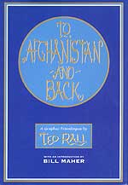
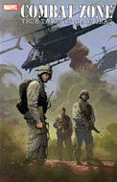
Case studies
“To Afghanistan and Back: A Graphic Travelogue”
by Ted Rall (NBM, 2002).
“Combat Zone: True Tales of GIs in Iraq vol. 1” by
Karl Zinsmeister (Writer) & Dan Jurgens (Penciller)
(Marvel Comics, 2005).

Slide 7
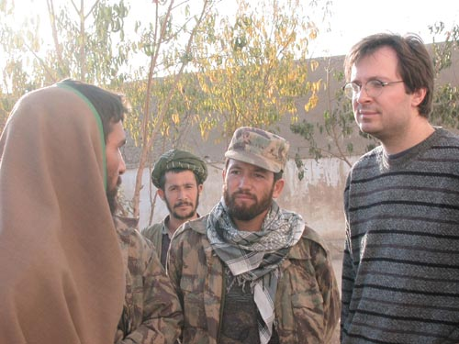
Case studies
“To Afghanistan and Back: A Graphic Travelogue”
Left Wing Writer
Independent Journalist
“Anti – Patriotic”
Circulation

Slide 8
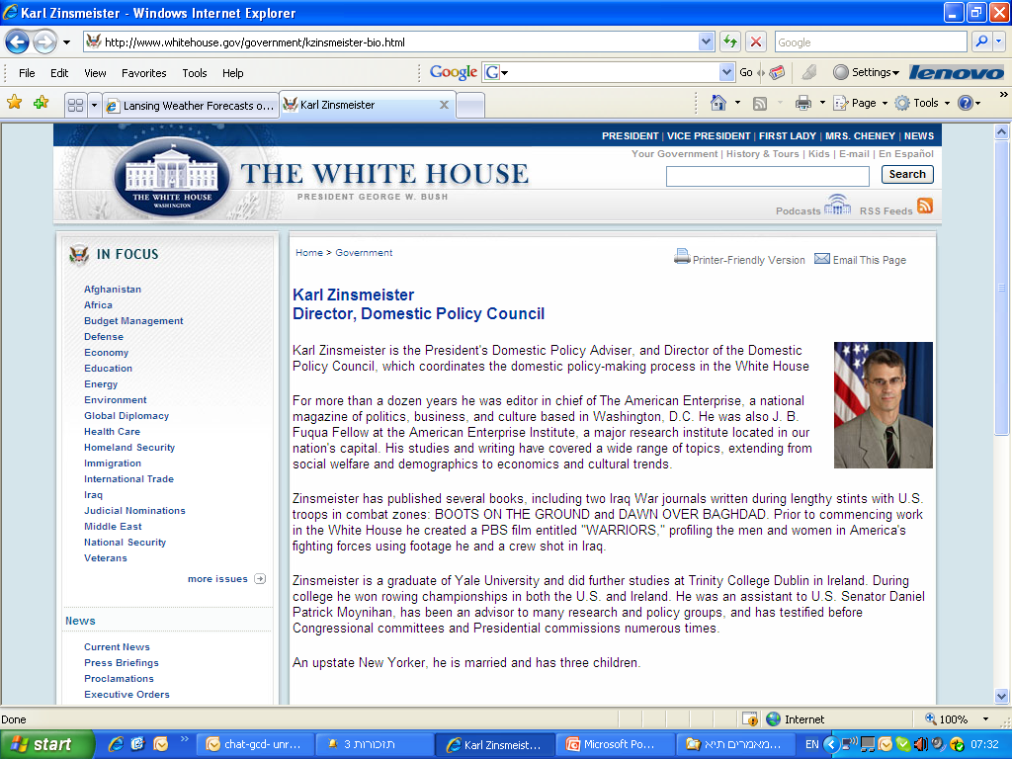
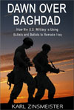
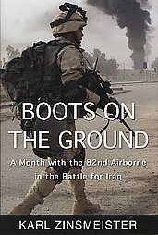
Case studies
“Combat Zone: True Tales of GIs in Iraq”
Right Wing Writer
Embedded Journalist
“Super - Patriotic”
Circulation

Slide 9
Survey’s collection method
Unobtrusive Internet search using Google.com.
Printed Materials search using Lexis-Nexis Database.
Survey’s population: 56 Different contents.
32 for “To Afghanistan and Back” and 24 for “Combat Zone”.

Slide 10
Early findings: Demographics
44 Males, Only 4 Women.
44 North-Americans
31 Christians (55%).
Diverse ethnicity
Content’s Sources
Political Affiliations
Missing values
A WASP Data Poll

Slide 11
Survey’s Main Findings
More people learnt new information from reading To Afghanistan
and Back (54% vs. 41%).
In both cases, comics had the effect of re-enforcing prior opinion
rather than changing a pre-existing one.
Those convinced in the policy were less affected than the opposing,
neutral and apathic groups

Slide 12
Questions?
Please write to me at:
Ofer@giriofer.com

